Slide 1
MATHS SPRINT
MATHEMATICS/SPEED

Slide 2
TEAM MEMBERS
ADEMUYIWA ADEKUNLE
OLABODE TOLULOPE
SOPITAN PRECIOUS
IKUJEBI KEHINDE
HERITAGE
OMOKEJIMI SAMUEL

Slide 3

A simple game to show how good you are with simple arithmetic
STATEMENT OF PROBLEM
We can only tell how good you are with simple arithmetic by how many simple questions you can answer correctly in a set of randomly generated questions

Slide 4
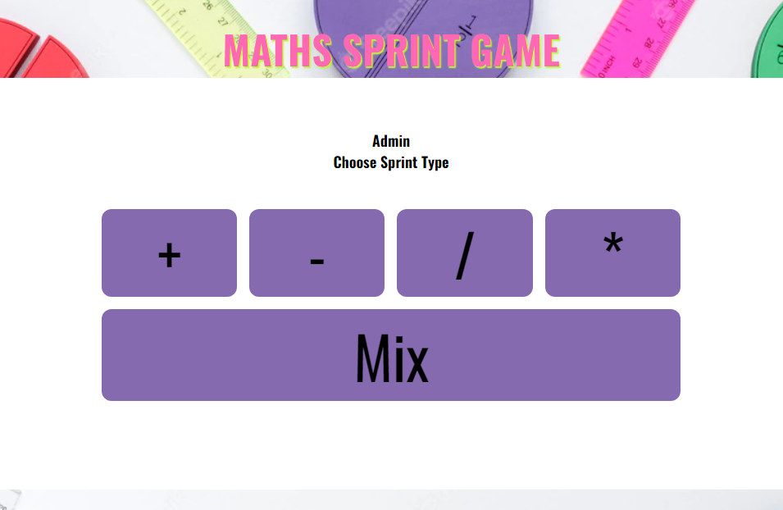
Our simple solution to test how good you are is to you run a Maths sprint! Base on your sprint choice (+-/* or any) strength (Number of questions) and speed.
Our Solution

Slide 5
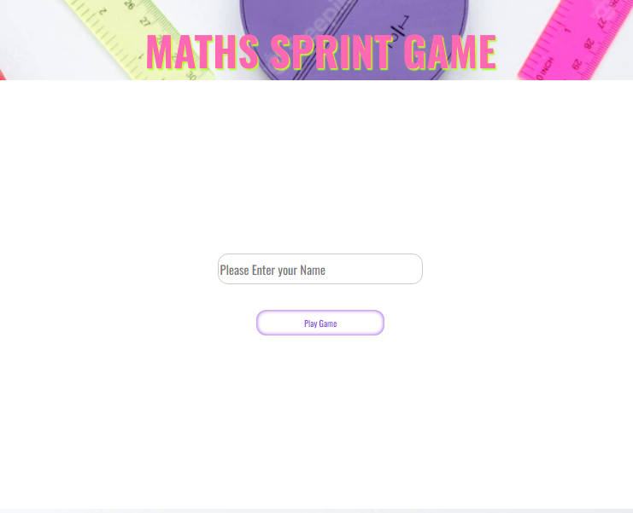
Testing our solution!

Slide 6
limitation
Single player
Questions based
UI/Work

Slide 7
Future Expansion
Better game Level
Better UI work
Better User Experience using animation and sound
Different Sprint Categories (Per Time and per Question or Both)
Advance level for complex algorithm
User of

Slide 8
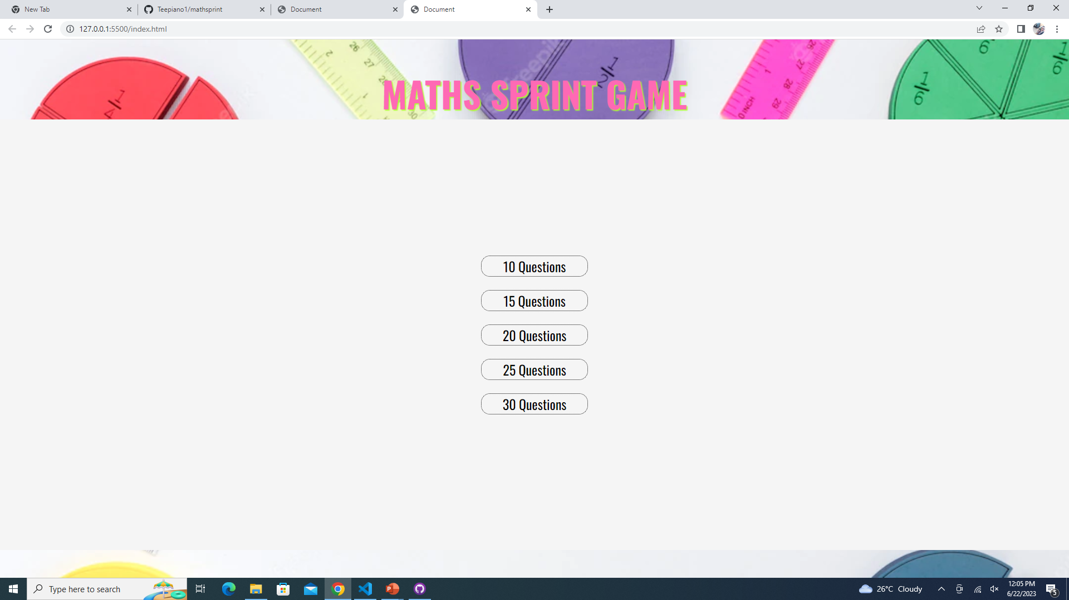
QUESTION SELECTION

Slide 9
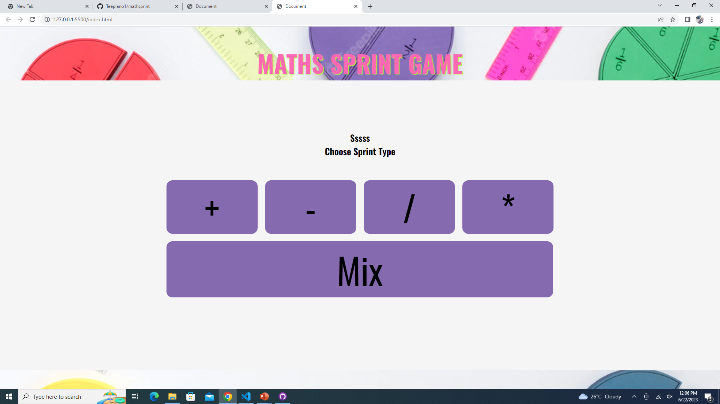

Slide 10
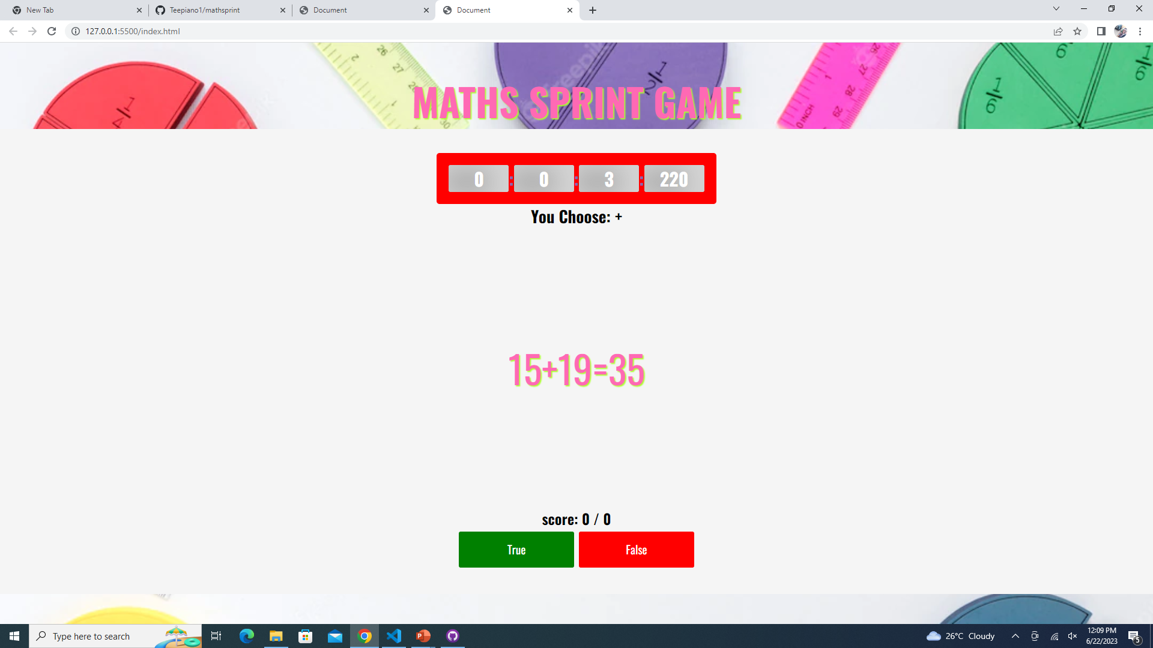

Slide 11
